Slide 1
LEVERAGING ML APPROACHES FOR DIABETES PREDICTION AND ANALYSIS
Research Questions
Model Performance Comparison?
Exploratory Data Insights?
Objectives
To develop machine models
To evaluate and compare the performance
To provide actionable insights

Slide 2
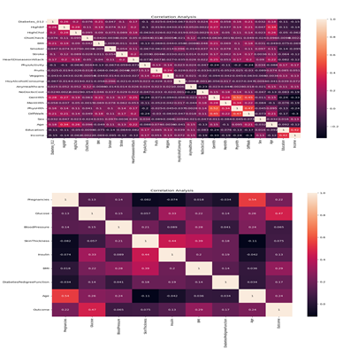
Insights from Exploratory Data Analysis
Correlation Heatmap for 1st and 2nd Dataset
Key Observations:
BRFSS Dataset:
Strong correlations between variables like BMI, Age, Physical Health (PhysHlth), and Diabetes progression.
High cholesterol and high blood pressure (HighBP, HighChol) are positively correlated with diabetes risk, especially for Diabetes 012 (target variable).
Pima Indians Dataset:
BMI and Glucose levels are strongly correlated with Diabetes outcome.
Pregnancies show a weaker correlation, but it still impacts Diabetes prediction.
Both datasets show that age and BMI are key predictors of diabetes risk, while Physical Health and General Health (GenHlth) are also important but to a lesser extent.

Slide 3
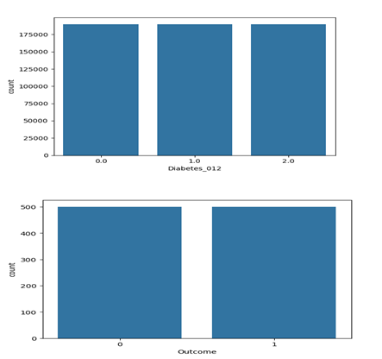
Preprocessing of Data
Balancing the 1st&2nd dataset
Key Observations:
Both datasets were initially imbalanced, with a higher proportion of non-diabetic cases.
Post-SMOTE, the datasets are now balanced with approximately equal representation across all diabetes classes, ensuring improved model performance and fairness.

Slide 4
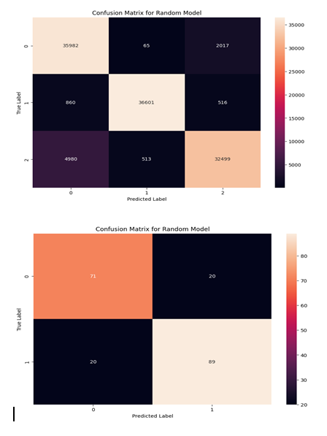
Model Evaluation Visuals
Confusion Matrix for Random Forest on 1st&2nd datasets
General Performance or Insights:
The Random Forest model handles the BRFSS dataset with more success due to the larger dataset and better handling of class imbalances.
The Pima Indians dataset shows better balanced performance, though a few misclassifications still persist, especially for non-diabetic cases.

Slide 5
Model Performance and Insights on Diabetes Prediction
Results of Model Performance on two datasets (BRFSS 2015 Diabetes and Pima Indians Diabetes)
Key Findings
Random Forest Model:
Performance: Achieved high accuracy (92.15%) on both datasets, with perfect training accuracy (99.63%) on the second dataset.
Strengths: Balanced performance across all diabetes classes and effectively handled class imbalances using SMOTE.
Recommendation: Random Forest is the most reliable model for predicting diabetes progression and should be the primary model used.
XGBoost Model:
Performance: Achieved 82.65% accuracy on the second dataset, but struggled with recall for diabetic cases.
Strengths: Efficient and fast model training, good at identifying non-diabetic cases.
Weaknesses: Lower recall for the diabetic class, requiring further tuning.
Recommendation: XGBoost can be used as a secondary model with further hyperparameter optimization to improve recall for diabetics.
SVM Model:
Performance: Achieved the lowest accuracy (72% on the first dataset and 52% on the second).
Weaknesses: Struggled with class imbalance and did not effectively classify diabetics and pre-diabetics.
Recommendation: SVM should be avoided for this task due to poor performance.
Insights from Data
Both datasets showed that factors like BMI, physical activity, age, blood pressure, and cholesterol levels are strongly correlated with diabetes progression. Class imbalance remained a challenge, but SMOTE helped balance the data and improved performance, especially for Random Forest and XGBoost.
Challenges and Limitations
Class Imbalance: Despite SMOTE, class imbalance, particularly with the pre-diabetic class, affected model performance.
Model Complexity: Random Forest and XGBoost require optimization for efficiency, especially on large datasets.
Interpretability: While effective, Random Forest and XGBoost lack interpretability compared to simpler models like logistic regression.
Conclusion
Random Forest is the most suitable model for predicting diabetes progression. XGBoost shows promise but requires further tuning, while SVM underperformed and should be avoided. Future work should explore other algorithms and optimize existing models.

